Slide 1
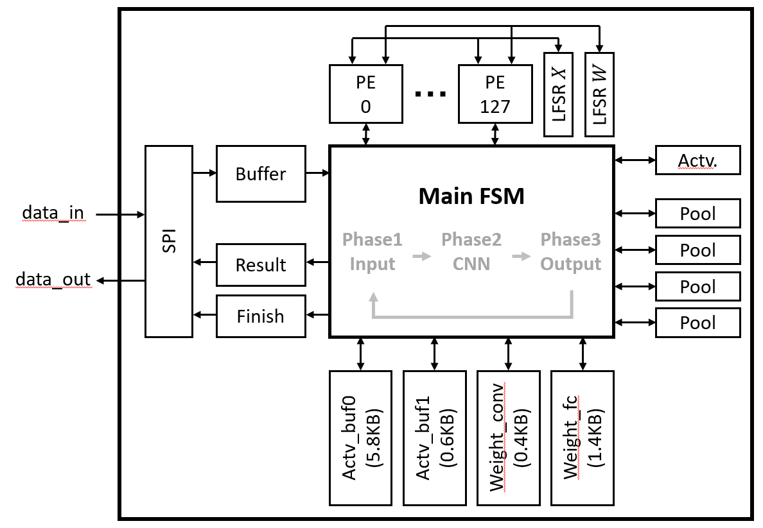
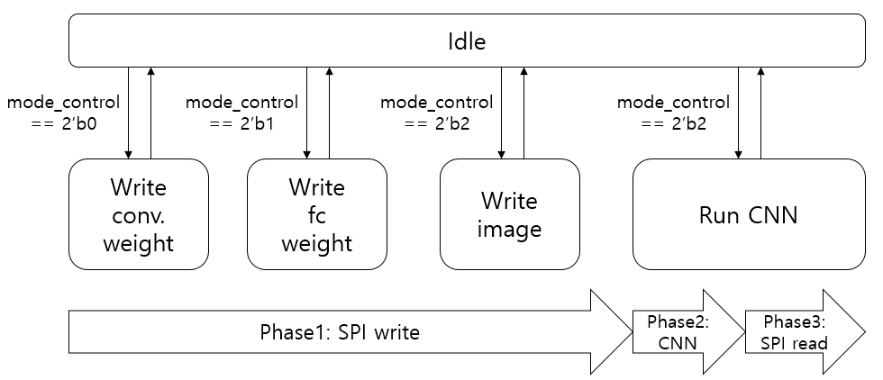
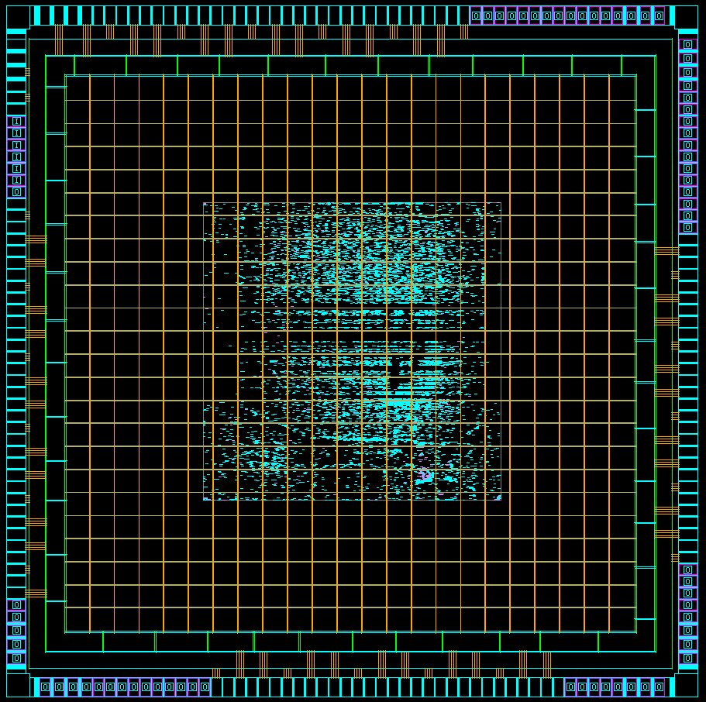
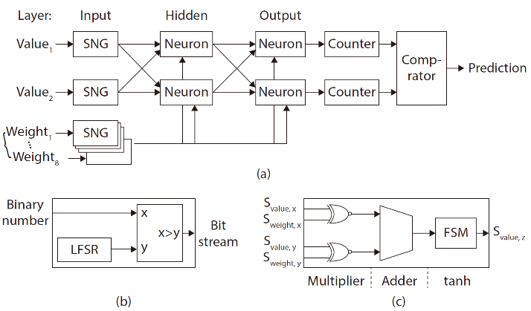
Area Efficient Neuromorphic Circuit Based on Stochastic Computation
Kiwon Yoon and Youngsoo Shin
School of Electrical Engineering, KAIST
INTRODUCTION
Deep learning application on mobile hardware requires neuromorphic circuit with small area.
Stochastic computing (SC) can replace conventional computing with simplified area while sacrificing accuracy.
We propose a new architecture of SC to reduce more area and design a neuromorphic circuit with proposed SC.
Error of SC depends on bit sequences of two bit streams.
LFSR seeds should be diverse to reduce calculation error.
II. CONVOLUTIONAL NEURAL NETWORK
Dataset: CIFAR-10 (60,000 images, 10 classes, 32×32 RGB)
Layers: 1 convolutional, 1 pooling, 1 fully-connected
Data format: represent value in [-1, 1] with 8 bits
Image prediction accuracy: 71%
IV. NEUROMORPHIC CIRCUIT DESIGN
Neurons (PE) shares single LFSR for value and weight each. But bits are differently shuffled for every neurons.
Buffers are allocated for activation and weight of each layer.
Data goes in and out via SPI protocol.
3 phases are repeated with 4 working and idle states.
Technology | 65nm 1P8M CMOS RF
Gate count | 315K
Flip-flop count | 83K
Chip area | 4mm × 4mm
Design area | 1.7mm × 1.7mm
Core voltage | 1.2V
I/O voltage | 3.3V
Dynamic power | 102mW
Leakage power | 0.07mW
Clock frequency | 100MHz
Latency | 25ms
Image resolution | 32×32×RGB
III. NEUROMORPHIC CIRCUIT WITH STOCHASTIC COMPUTING
Components: SNG (binary→bit stream), neuron, counter(bit stream→binary), comparator
Stochastic number generator (SNG) includes random number generator (LFSR) and comparator.
AND works as a multiplier with small circuit area.
V. CONCLUSION
A neuromorphic circuit is designed by applying stochastic computing to minimize area.
VI. ACKNOWLEDGEMENT
The chip fabrication and EDA tool were supported by the IC Design Education Center(IDEC), Korea.

